Slide 1
Deep Learning for THz Channel Estimation and Beamforming Prediction via Sub-6GHz Channel
Abhishek K. Gupta
Assistant Professor,
Electrical Engineering, IIT Kanpur
Co-Authors: Sagnik Bhattacharya
July 2022
International Conference on Signal Processing and Communications (SPCOM)

Slide 2


Communications at Terahertz (THz) Frequencies
Emerging wireless applications
Augmented reality, ultra-low latency video conferencing.
Requiring data rates in Tb/s.
Even mmWave assisted 5G may fall short of requirement.
Use of THz spectrum is inevitable.
Challenges of THz signals
Exponential pathloss decay due to atmospheric attenuation,
High blockage and penetration losses.
Implications
Ultra dense base station (BS) deployment
Large antenna arrays with analog/hybrid beamforming.
Analog/hybrid beamforming
THz BS
User devices
S. Tripathi, N. V. Sabu, A. K. Gupta and H. S. Dhillon, ''Millimeter-wave and Terahertz Spectrum for 6G Wireless,'' in 6G Mobile Wireless Networks, Springer. 2021

Slide 3


THz Channel Estimation
Real-time and reasonably accurate THz channel estimation is required.
Conventional channel estimation methods, e.g. least square (LS) or linear minimum mean squared (LMMS) estimation, require large number of uplink pilot signals due to large antenna array at THz
Significant overhead considering real-time applications.
Not viable.
Sub-6GHz channel, on the other hand, can be estimated with a smaller number of uplink pilots
Relatively low overhead.
$$θ_{t}$$
Angle of Departure
$$θ_{r}$$
Angle of Arrival
Can we estimate THz channel from Sub-6GHz channel values?

Slide 4
THz Channel Estimation
Real-time and reasonably accurate THz channel estimation is required.
Conventional channel estimation methods, e.g. least square (LS) or linear minimum mean squared (LMMS) estimation, require large number of uplink pilot signals due to large antenna array at THz
Significant overhead considering real-time applications.
Not viable.
Sub-6GHz channel, on the other hand, can be estimated with a smaller number of uplink pilots
Relatively low overhead.
$$θ_{t}$$
Angle of Departure
$$θ_{r}$$
Angle of Arrival
Can we estimate THz channel from Sub-6GHz channel values?
Can we take transmitter side decision from Sub-6GHz channel values?
Beam selection
BS selection
Blockage prediction

Slide 5
Cascaded Architecture
THz Channel values
Beam selection

Slide 6
Cascaded Architecture
THz Channel values
Beam selection
Direct estimation of THz channel matrix computationally expensive
Sub 6GHz Channel values
THz Channel values
Beam selection

Slide 7
Cascaded Architecture
THz Channel values
Beam selection
Direct estimation of THz channel matrix computationally expensive
Sub 6GHz Channel values
THz Channel values
Beam selection
Sub 6GHz Channel values
THz Channel factors
Beam selection
Computationally expensive THz channel matrix estimation and exhaustive codebook search bypassed.
Angles of arrival and departure,
Time of arrival,
phase change on arrival

Slide 8
Cascaded Architecture
Sub 6GHz Channel values
THz Channel factors
Beam selection

Slide 9
Cascaded Architecture
Sub 6GHz Channel values
THz Channel factors
Beam selection
Given the uplink Sub-6GHz channel matrix
Estimate the channel factors for N strongest THz channel paths between BS and user in a computationally efficient manner
N is a pre-specified constant.
Given the estimated THz channel factors between a BS and a user,
Predict the optimal analog beamformer from a pre-specified codebook, in a computationally efficient manner
Phase 1
Phase II
Deep Learning algorithms efficiently map otherwise intractable functions, using training data.
Convolutional Neural Networks (CNN) - suitable for extracting spatial/temporal features directly from raw data.

Slide 10

Cascaded Architecture
Phase 1
Phase II
Sub 6GHz Channel values
THz Channel factors
CNN
NN
Beam selection
Can be modified for other applications
BS selection
Outage prediction
Deep Learning algorithms efficiently map otherwise intractable functions, using training data.
Convolutional Neural Networks (CNN) - extremely successful at extracting spatial/temporal features directly from raw data.

Slide 11
System Model
Sub-6GHZ
antenna
array
N_{s}
antennas
Uplink Sub-6 GHz Channel
…
THz antenna
array
…
N_{T}
antennas
User
Basestation
Downlink
THz Channel

Slide 12

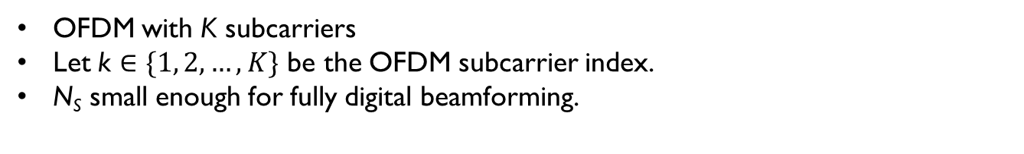

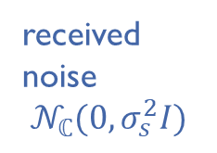


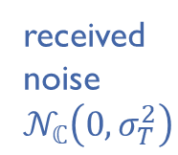
Channel Model
Sub-6GHZ
antenna
array
N_{s}
antennas
…
THz antenna
array
…
N_{T}
antennas
User
Base station
Uplink Sub-6 GHz Channel
Downlink THz Channel
$y_{s}\left[k\right]=h_{s}\left[k\right]{ x}_{s}\left[k\right]+n_{s}\left[k\right]$
$$y_{T}[k]=h_{T}^{H}[k] p{ x}_{T}[k]+n_{T}[k]$$
received uplink
sub-6 symbol
vector
sub-6 channel vector
from UE to BS
input
symbol
received
noise
$$𝒩_{ℂ}(0,σ_{s}^{2}I)$$
downlink
received
symbol
at THz
THz
channel
vector
from
BS to UE
chosen beam
former
from P
transmit
symbol
received
noise
$$𝒩_{ℂ}\left(0,σ_{T}^{2}\right)$$
$ℂ^{Ns×1}$
$$ℂ^{𝒩_{T}×1}$$
OFDM with K subcarriers
Let k $∈\{1, 2,…,K\}$ be the OFDM subcarrier index.
N_{S} small enough for fully digital beamforming.
Fully analog beamforming adopted for THz scenario, single RF chain with N_{T} quantized phase shifters.
Pre-suppled codebook P comprises all candidate beamformers.

Slide 13



Channel Model
Geometric channel model (both Sub-6GHz and THz)
Sub-6GHz channel :
$$h_{s}\left[k\right]=\sum_{m=0}^{M−1}{λ_{m} α_{r,m}\left(φ_{r,m},θ_{r,m}\right) α_{t,m}^{∗}(φ_{t,m}θ_{t,m})}$$
$k$ = OFDM subcarrier index
$M$ = number of channel paths
$λ_{m}$ = path gain
$φ_{r,m}$ and $θ_{r,m}$ = azimuth and elevation angles of arrival
$φ_{t,m}$ and $θ_{t,m}$ = azimuth and elevation angles of departure
$$θ_{t},φ_{t}$$
Angle of Departure
$$θ_{r},Φ_{r}$$
Angle of Arrival
for Mth channel path
for Mth channel path

Slide 14
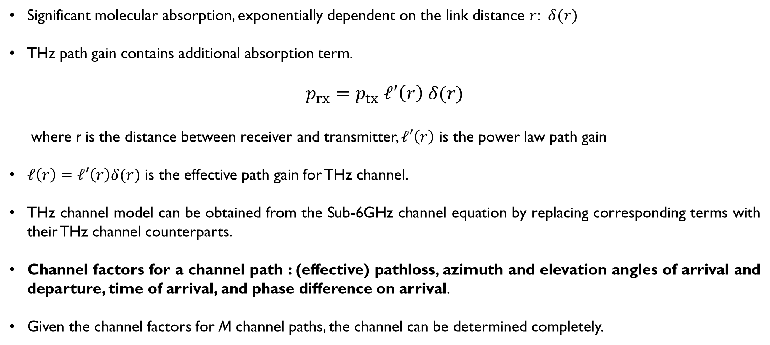
Channel Model for THz
Significant molecular absorption, exponentially dependent on the link distance $r$: $δ(r)$
THz path gain contains additional absorption term.
$$p_{rx}=p_{tx} ℓ′\left(r\right) δ(r)$$
where r is the distance between receiver and transmitter, $ℓ′\left(r\right)$ is the power law path gain
$ℓ\left(r\right)=ℓ′\left(r\right)δ(r)$ is the effective path gain for THz channel.
THz channel model can be obtained from the Sub-6GHz channel equation by replacing corresponding terms with their THz channel counterparts.
Channel factors for a channel path : (effective) pathloss, azimuth and elevation angles of arrival and departure, time of arrival, and phase difference on arrival.
Given the channel factors for M channel paths, the channel can be determined completely.

Slide 15
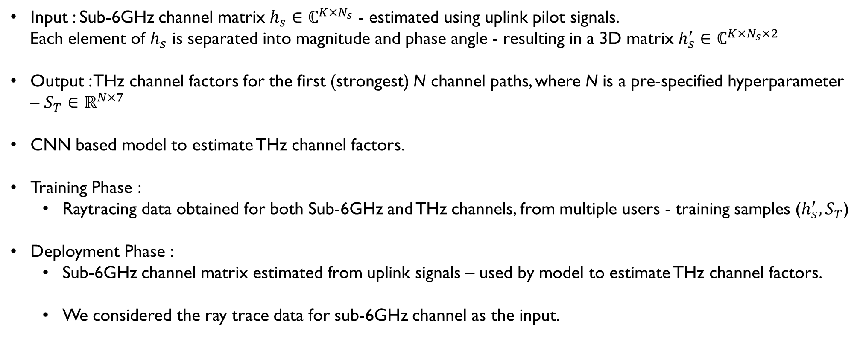
Phase I: THz Channel Factors Estimation
Input : Sub-6GHz channel matrix $h_{s}∈ℂ^{K×N_{s}}$ - estimated using uplink pilot signals.
Each element of $h_{s}$ is separated into magnitude and phase angle - resulting in a 3D matrix $h_{s}^{′}∈$ $ℂ^{K×N_{s}×2}$
Output : THz channel factors for the first (strongest) N channel paths, where N is a pre-specified hyperparameter – $S_{T}∈ℝ^{N×7}$
CNN based model to estimate THz channel factors.
Training Phase :
Raytracing data obtained for both Sub-6GHz and THz channels, from multiple users - training samples ($h_{s}^{′},S_{T}$)
Deployment Phase :
Sub-6GHz channel matrix estimated from uplink signals – used by model to estimate THz channel factors.
We considered the ray trace data for sub-6GHz channel as the input.

Slide 16
Phase I: Proposed Learning Network’s Architecture
Conv
(filters with pre-specified kernel size)
Conv
Conv
Maxpool (dimension reduction)
Maxpool
Maxpool
Instance Normalization
Instance Normalization
Input
(Sub-6GHz channel)
Output (THz factors)
Rectified Linear Unit
Rectified Linear Unit
Dense layer
(neurons dropped randomly at runtime – prevents overfitting)
Dropout
Dropout
Global Average Pooling (dimension reduction)
2 “Convolution-based” layers

Slide 17
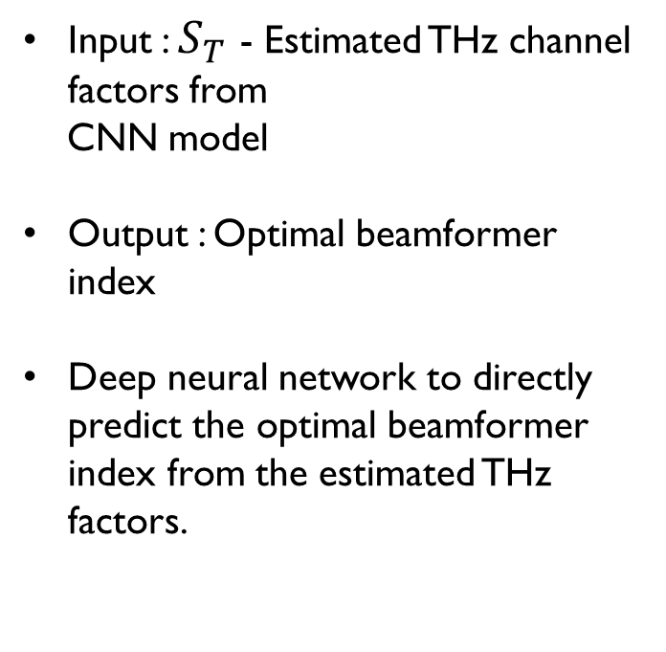
Phase II: Optimal Analog Beamformer Prediction
Input : $S_{T}$ - Estimated THz channel factors from
CNN model
Output : Optimal beamformer index
Deep neural network to directly predict the optimal beamformer index from the estimated THz factors.
Dense
Dense
Rectified Linear Unit
…
Softmax (multi-class classification)
Estimated THz
factors
Dropout
Output
(Optimal Beamformer )
4 Dense Layers

Slide 18
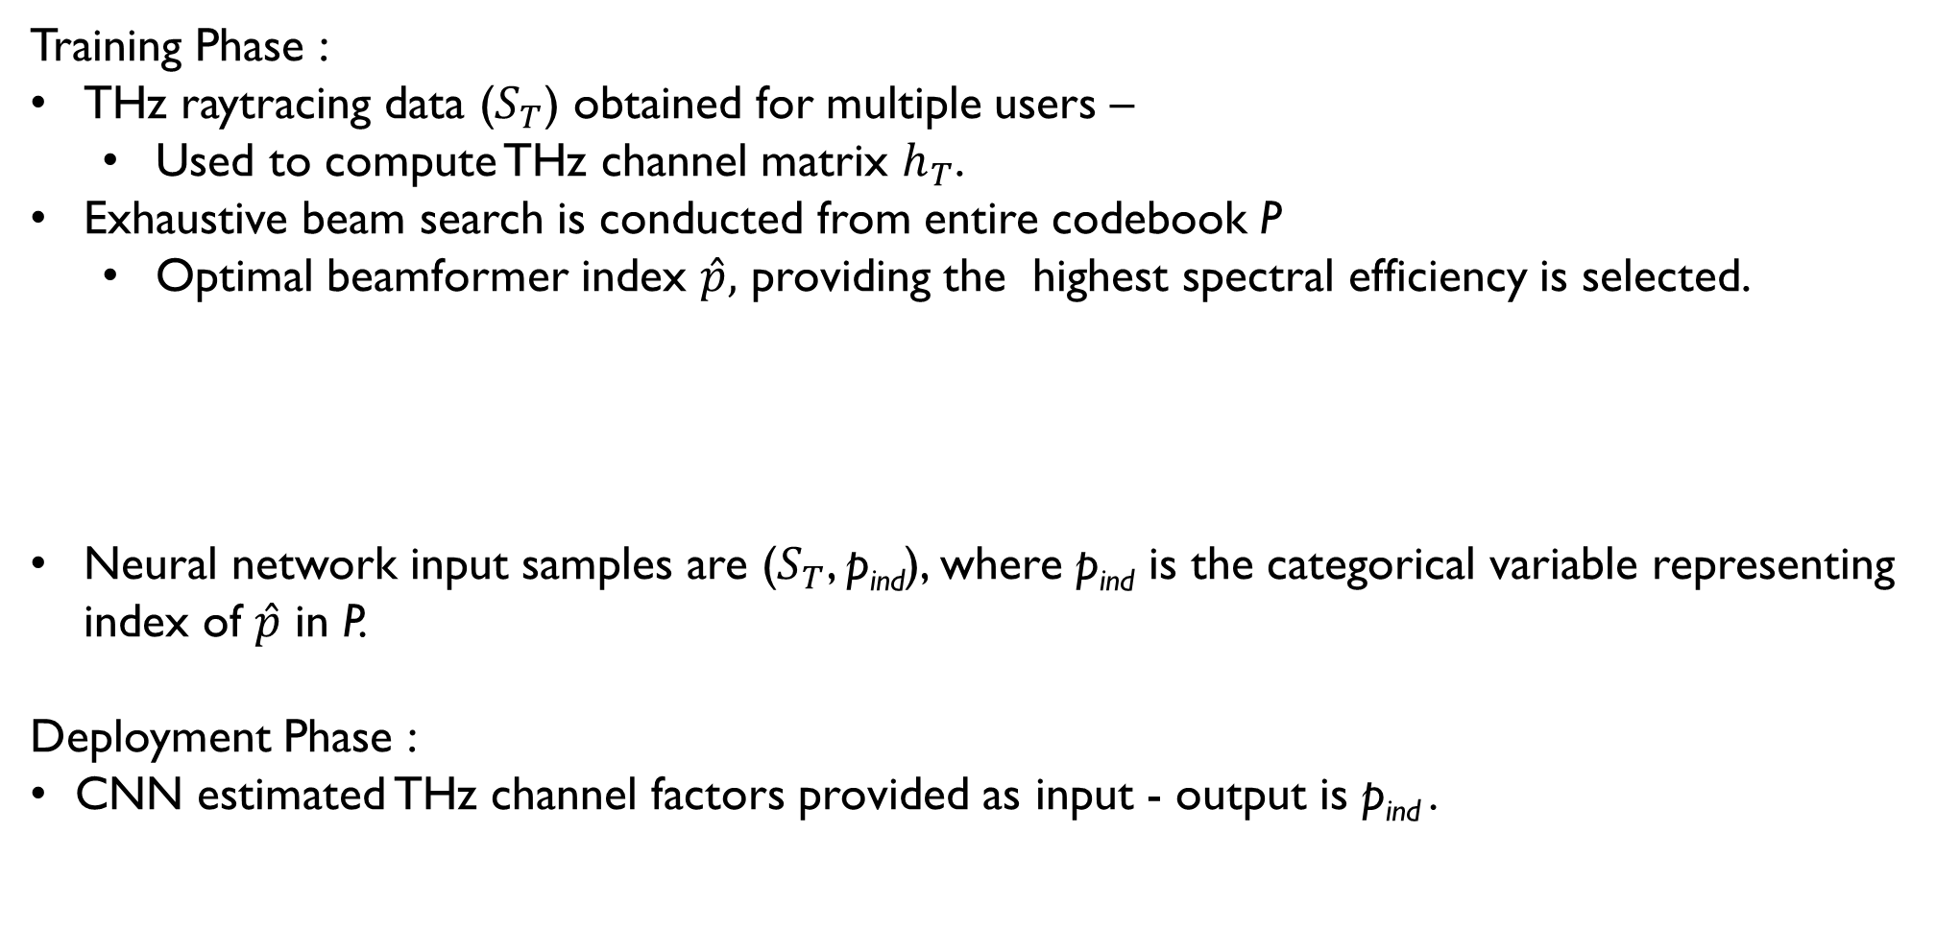
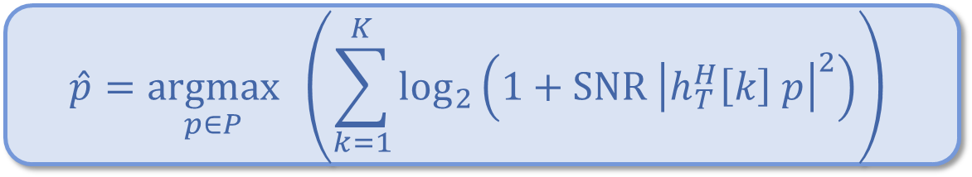
Phase II: Optimal Analog Beamformer Prediction
Training Phase :
THz raytracing data ($S_{T}$) obtained for multiple users –
Used to compute THz channel matrix $h_{T}$.
Exhaustive beam search is conducted from entire codebook P
Optimal beamformer index $\hat{p},$ providing the highest spectral efficiency is selected.
Neural network input samples are ($S_{T}$, p_{ind}), where p_{ind} is the categorical variable representing index of $\hat{p}$ in P.
Deployment Phase :
CNN estimated THz channel factors provided as input - output is p_{ind} .
$$\hat{p}=\underset{p∈P}{argmax}{ \left(\sum_{k=1}^{K}{\log_{2}\left(1+SNR {\left|h_{T}^{H}\left[k\right] p\right|}^{2}\right)}\right)}$$

Slide 19
Performance Evaluation
Baseline Algorithm :
1. THz channel matrix, computed from raytracing, passed into a deep learning model to output optimal beamformer index.
2. Model comprises a convolutional layer, followed by GAP, ReLU, and 4 dense layers, each followed by ReLU and dropout layers. Softmax function at the end outputs beamformer index.
Upper Bound :
Exhaustive codebook search using raytracing derived THz channel matrix – to find the optimal beamformer by brute force.
Computationally prohibitive for real-time applications

Slide 20
Neural Network Hyperparameters
The neural network hyperparameters for the CNN based THz factors estimation, and the beamformer prediction models are the following:
Hyperparameter | THz Estimation | Beamformer Prediction
Conv kernel size | (2,2) | -
Conv no. of filters | 64 | -
Maxpool kernel size | (2,2) | -
Maxpool stride length | 2 | -
Dense layer dimension | - | 64
No. of training samples | 80,000 | 80,000
No. of test samples | 20,000 | 20,000
No. of epochs | 100 | 100
Task objective | Regression | Classification
Optimizer | Stochastic gradient descent | Adam
Initial learning rate (LR) | 10⁻³ | 10⁻²
LR decay factor | 0.1 | -
LR decay schedule | 80 epochs | -
Momentum | 0.8 | -
Dropout | 0.2 | 0.2

Slide 21
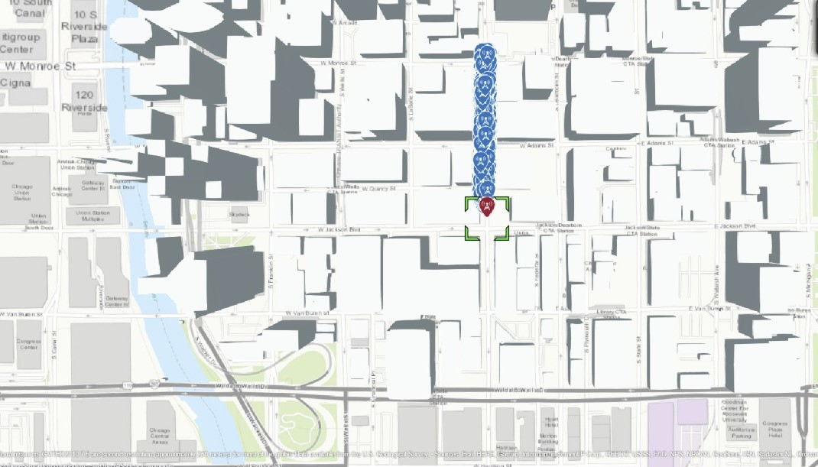
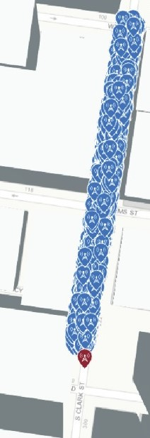
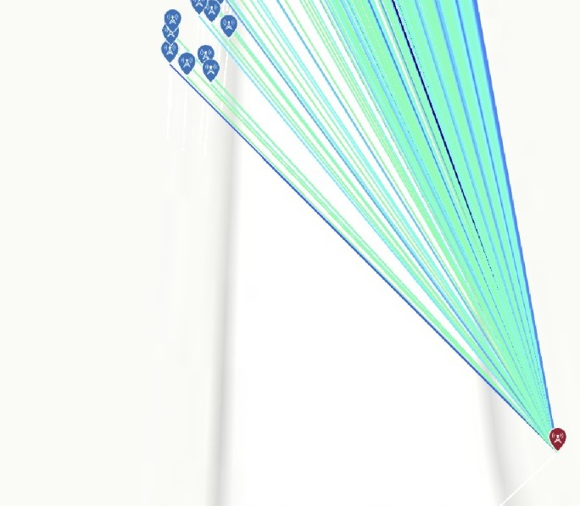
Simulation
Raytracing Scenario is generated using MATLAB raytrace function from Communications Toolbox.
Outdoor environment, rectangular block of dimensions (400m $×$ 30m) in S Clarke St., Chicago downtown area.
BS at one corner of rectangular block, user locations randomly generated inside block – raytracing data gathered.
Location of BS (red) and users (blue) in Chicago
Zoomed in scenario – S Clarke St.
Raytracing – highly zoomed in

Slide 22
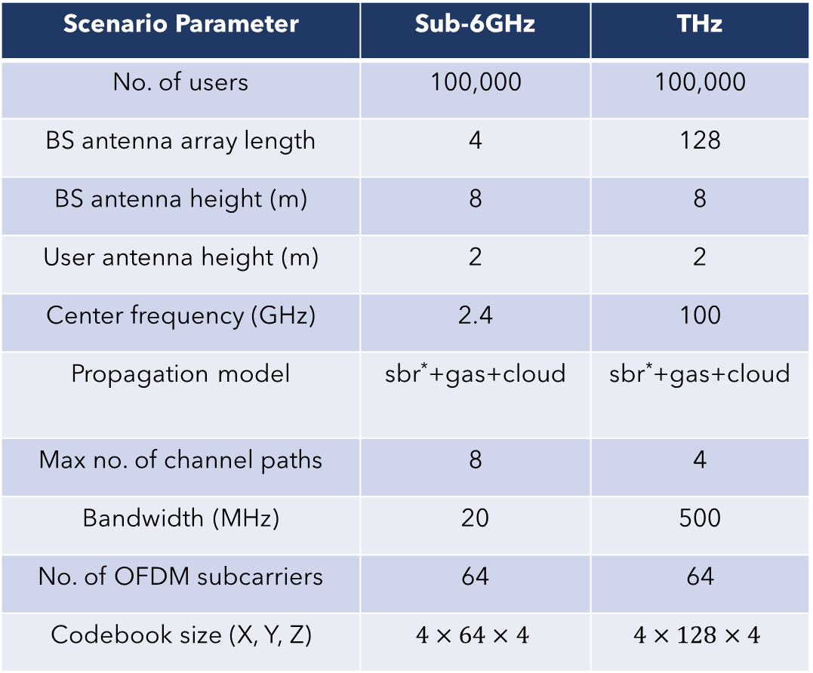
Simulation Parameters
Scenario Parameter | Sub-6GHz | THz
No. of users | 100,000 | 100,000
BS antenna array length | 4 | 128
BS antenna height (m) | 8 | 8
User antenna height (m) | 2 | 2
Center frequency (GHz) | 2.4 | 100
Propagation model | sbr*+gas+cloud | sbr*+gas+cloud
Max no. of channel paths | 8 | 4
Bandwidth (MHz) | 20 | 500
No. of OFDM subcarriers | 64 | 64
Codebook size (X, Y, Z) | $$4×64×4$$ | $$4×128×4$$
* - sbr = shooting and bouncing rays propagation model

Slide 23
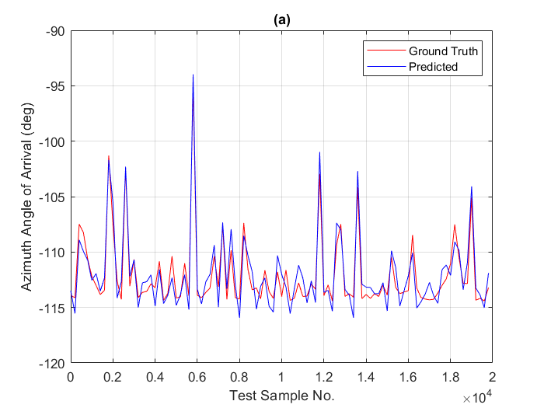
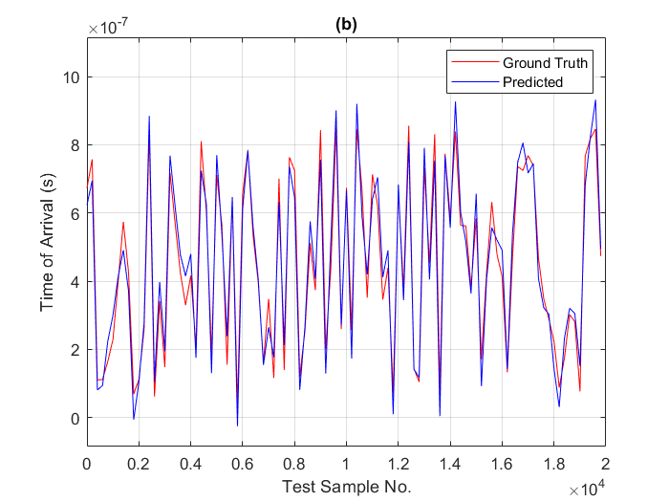
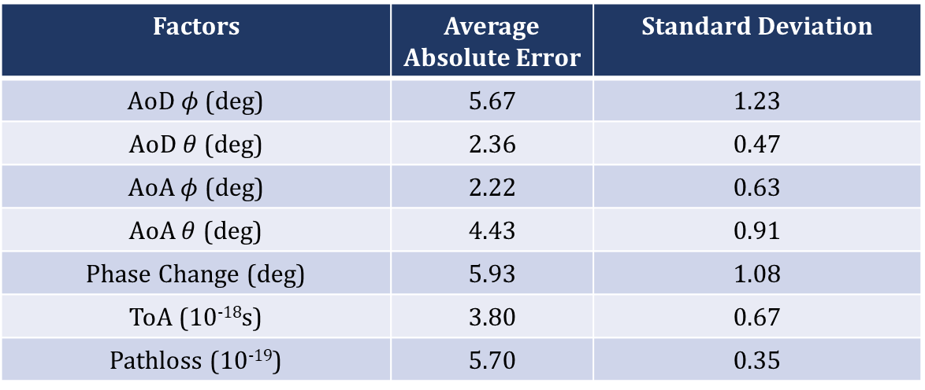
Performance Evaluation: THz Channel Factors Estimation
Table shows mean and standard deviation absolute errors of proposed algorithm’s THz channel factors predictions.
Error values show high estimation accuracy (<6 degree for AoA, AoD, and Phase Change estimates; and very low errors on ToA and Pathloss as well).
Figures show the graph of two THz channel factors as examples - Azimuth Angle of Arrival and Time of Arrival versus No. of samples.
Factors | Average Absolute Error | Standard Deviation
AoD $φ$ (deg) | 5.67 | 1.23
AoD $θ$ (deg) | 2.36 | 0.47
AoA $φ$ (deg) | 2.22 | 0.63
AoA $θ$ (deg) | 4.43 | 0.91
Phase Change (deg) | 5.93 | 1.08
ToA (10⁻¹⁸s) | 3.80 | 0.67
Pathloss (10⁻¹⁹) | 5.70 | 0.35

Slide 24
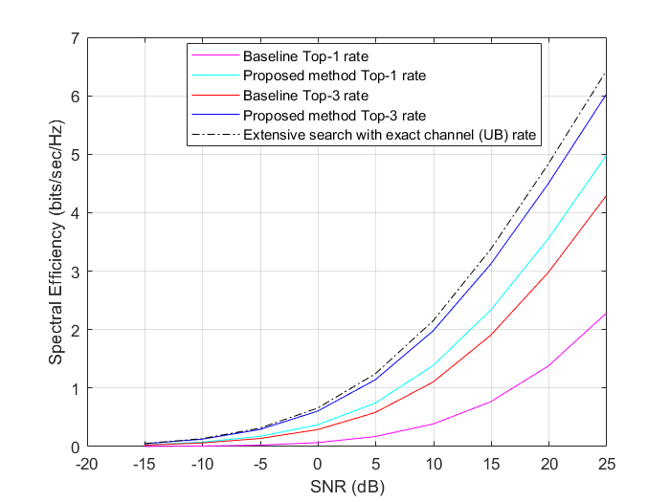
Performance Evaluation: Beamformer Prediction
Top-3 rate – 3 best beams predicted by model
Top-1 rate – best beam predicted by model
Wide range of SNR values (-17dB to 25dB)
considered.
Proposed algorithm Top-3 rate approaches
computationally prohibitive upper bound
spectral efficiency – proving the accuracy of
estimated THz channel factors.
Proposed algorithm Top-1 rate outperforms
Baseline Top-1 and Top-3 rates - validating our
Sub-6GHz based approach.
Baseline method inefficient because of THz channel
matrix input (high dimensionality).
Baseline model is underperforming compared to our Sub-6GHz based proposed algorithm – because severe THz attenuation renders the THz channel matrix highly noisy; not suitable for deep learning.
Upper
Bound
Proposed
Baseline

